Slide 1

Ready for the next health revolution?

Slide 2
WATER.
2022 | Lithuania

Slide 3

You are water
Water makes up 3/4 of our bodies
75%
2022 | Lithuania

Slide 4

Blood is almost all water
Blood needs good quality water to keep you happy and healthy
91%
2022 | Lithuania

Slide 5
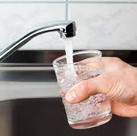
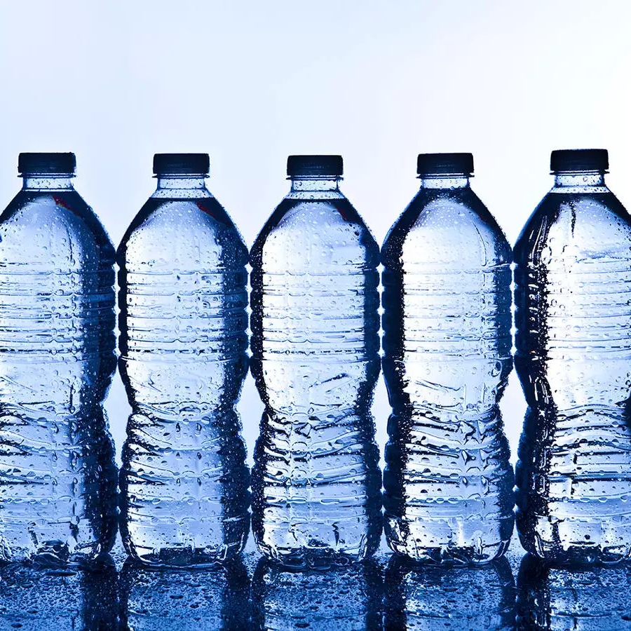

Is it dead or alive?
The water you drink
2022 | Lithuania
Dead
Dead
Where do we find living water?

Slide 6
Ionised alkaline water to the rescue
2022 | Lithuania

Slide 7
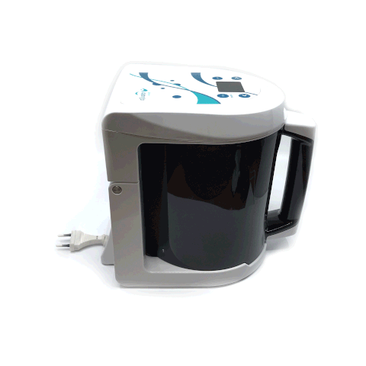
How we make it
Ionised Alkaline water
2022 | Lithuania

Slide 8
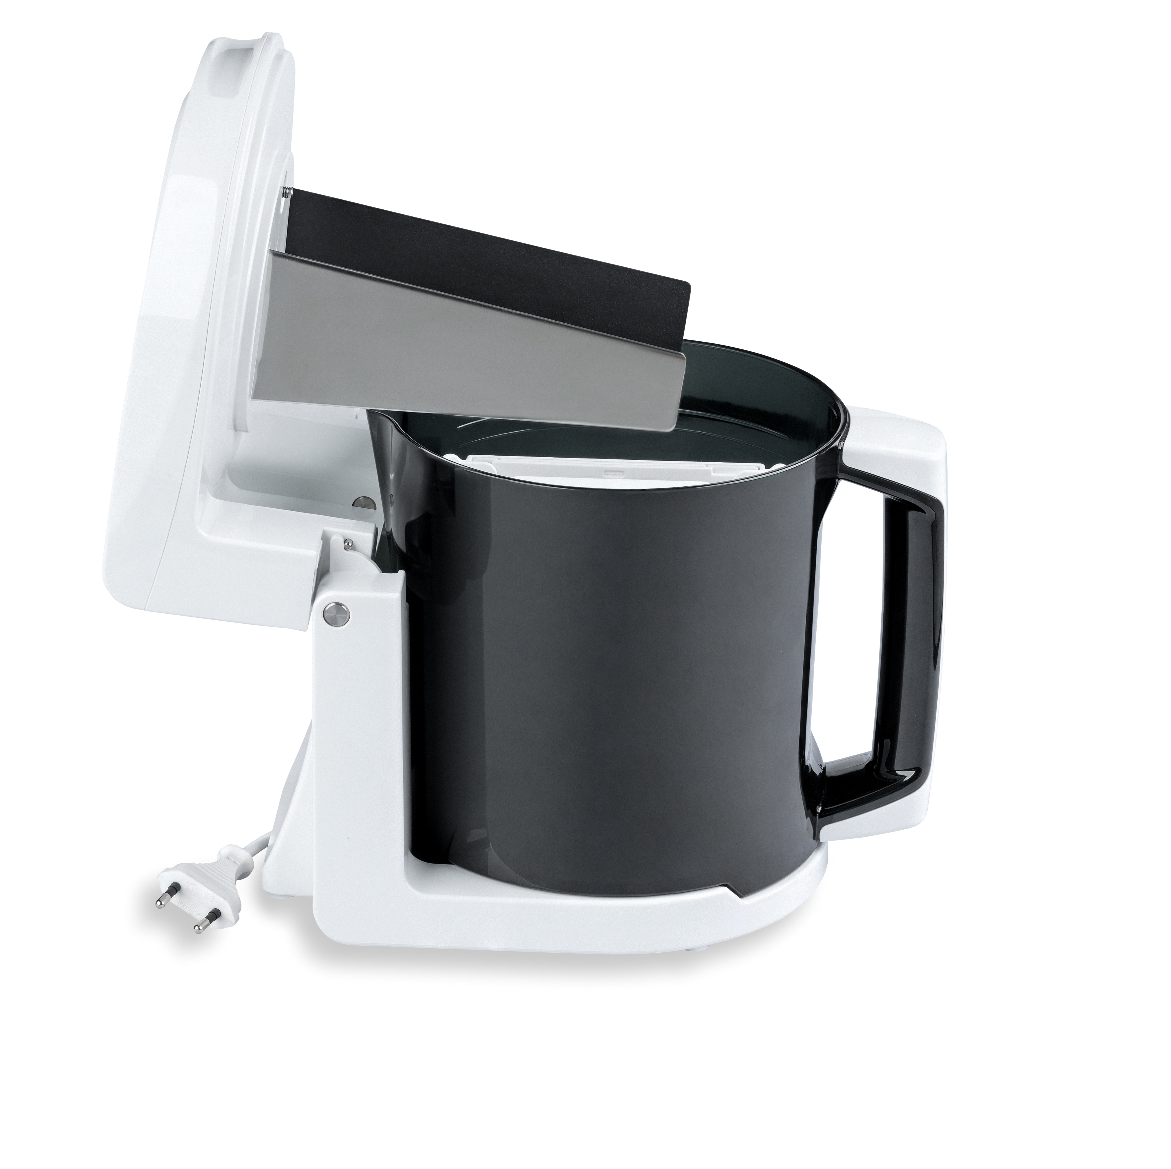
Inside an ioniser
Ionised Alkaline water
2022 | Lithuania

Slide 9
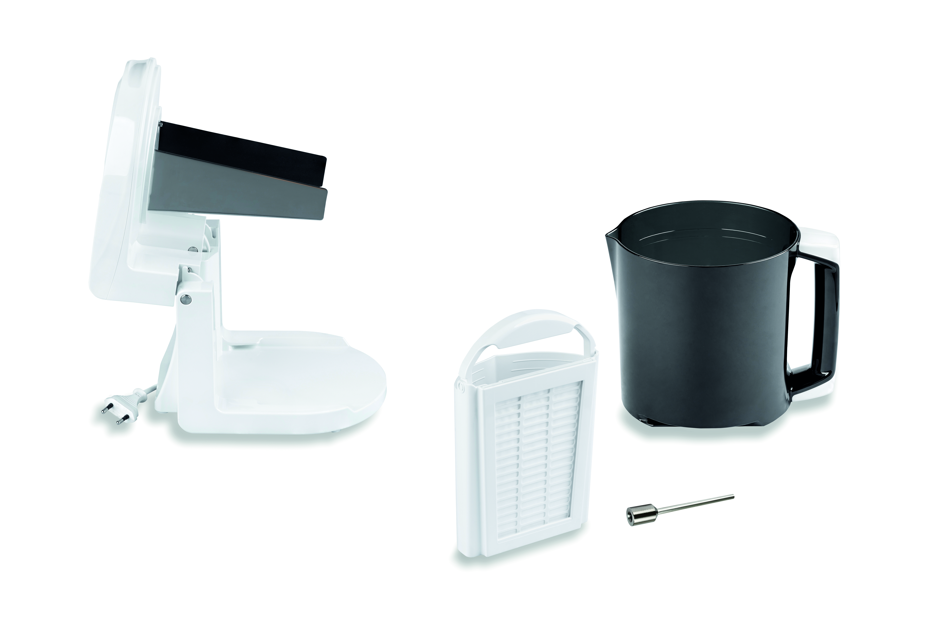
Inside an ioniser
Ionised Alkaline water
2022 | Lithuania

Slide 10
The obvious benefit
Ionised alkaline water
Tasty!
2022 | Lithuania

Slide 11
2022 | Lithuania
alkaline
acidic
silvered

Slide 12
2022 | Lithuania
alkaline
acidic
silvered

Slide 13
pH
0
8
14
2022 | Lithuania
Acidic
Alkaline

Slide 14
The culprits
Fruits and vegetables
Ph imbalance
Alkaline
Stress and pollution
Alcohol and medication
2022 | Lithuania
Acidic
Junk and animal foods, sweets

Slide 15
Some of the consequences
pH imBALANCE
Kidney problems
Arthritis
Acid
reflux
Weight issues
Eczema
Exhaustion
2022 | Lithuania
Heart problems
diabetes
Sclerosis
High
blood pressure
Alzheimer’s disease
Cancer

Slide 16
The hidden benefits
Alkaline water
Best quality drinking water
Full of minerals
Helps maintain ph balance
2022 | Lithuania
Clears pestici-des from food
Helps with stomach acidity
And much more!

Slide 17
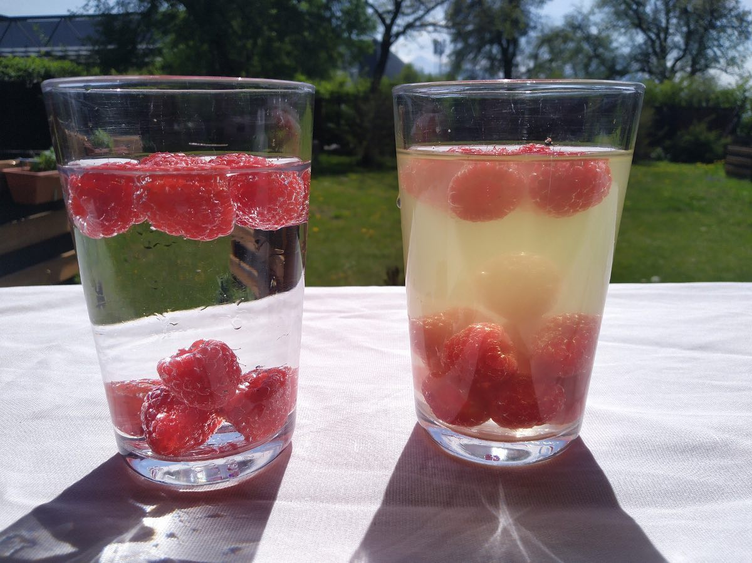
What happens to your fruits?
All water is not made the same
2022 | Lithuania
Tap water
Ionised alkaline water

Slide 18
2022 | Lithuania
alkaline
acidic
silvered
mineralised
antioxidant

Slide 19
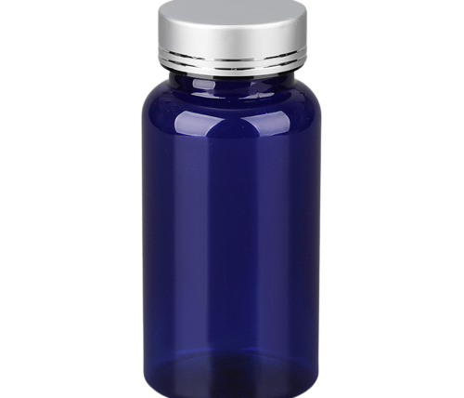
Thousands of euros per year
Value of the dietary supplement market, in billion euros
2022 | Lithuania
Source: Statista, 2020.

Slide 20
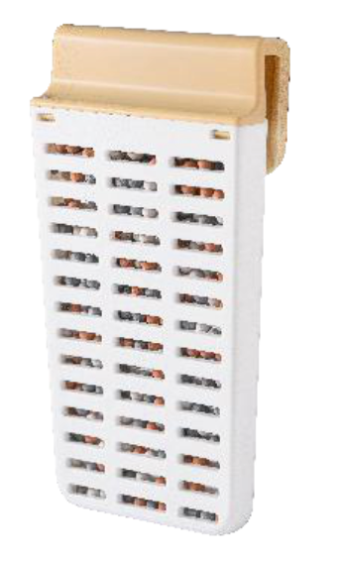
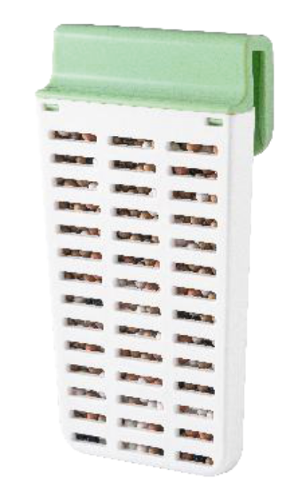
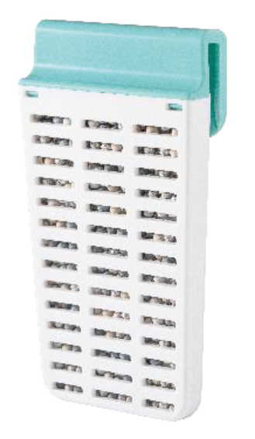
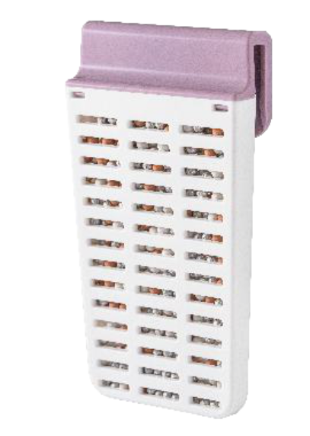
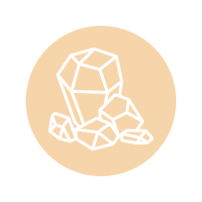



Choose your minerals
Ionised alkaline water
2022 | Lithuania
Relax
Protection
Wellness
Beauty

Slide 21
2022 | Lithuania
alkaline
acidic
silvered
mineralised
antioxidant

Slide 22
What is oxidation?
2022 | Lithuania

Slide 23
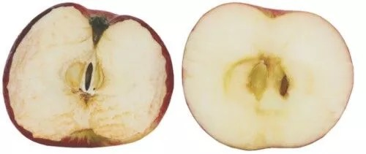
What’s going on with the apple?
Water can act as an antioxidant
2022 | Lithuania
Natural oxidation
Antioxidation

Slide 24
2022 | Lithuania
alkaline
acidic
silvered

Slide 25
What is it good for?
Acidic water
Disin-fecting food
Disin-fecting surfaces
Clean-ing wounds
2022 | Lithuania
Healing skin irrita-tions
Nourish-ing plants
And much more!

Slide 26
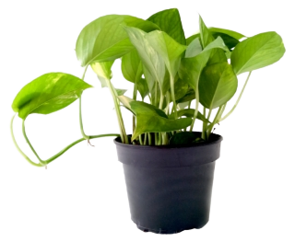
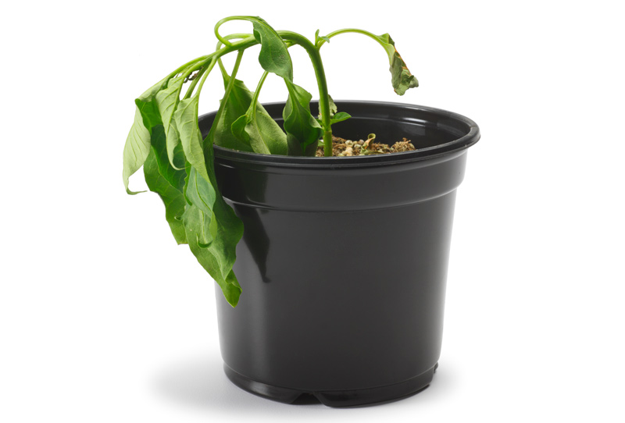
Nourishing your plants with acidic water
Your plant saviour
2022 | Lithuania
Before
After

Slide 27
2022 | Lithuania
alkaline
acidic
silvered

Slide 28
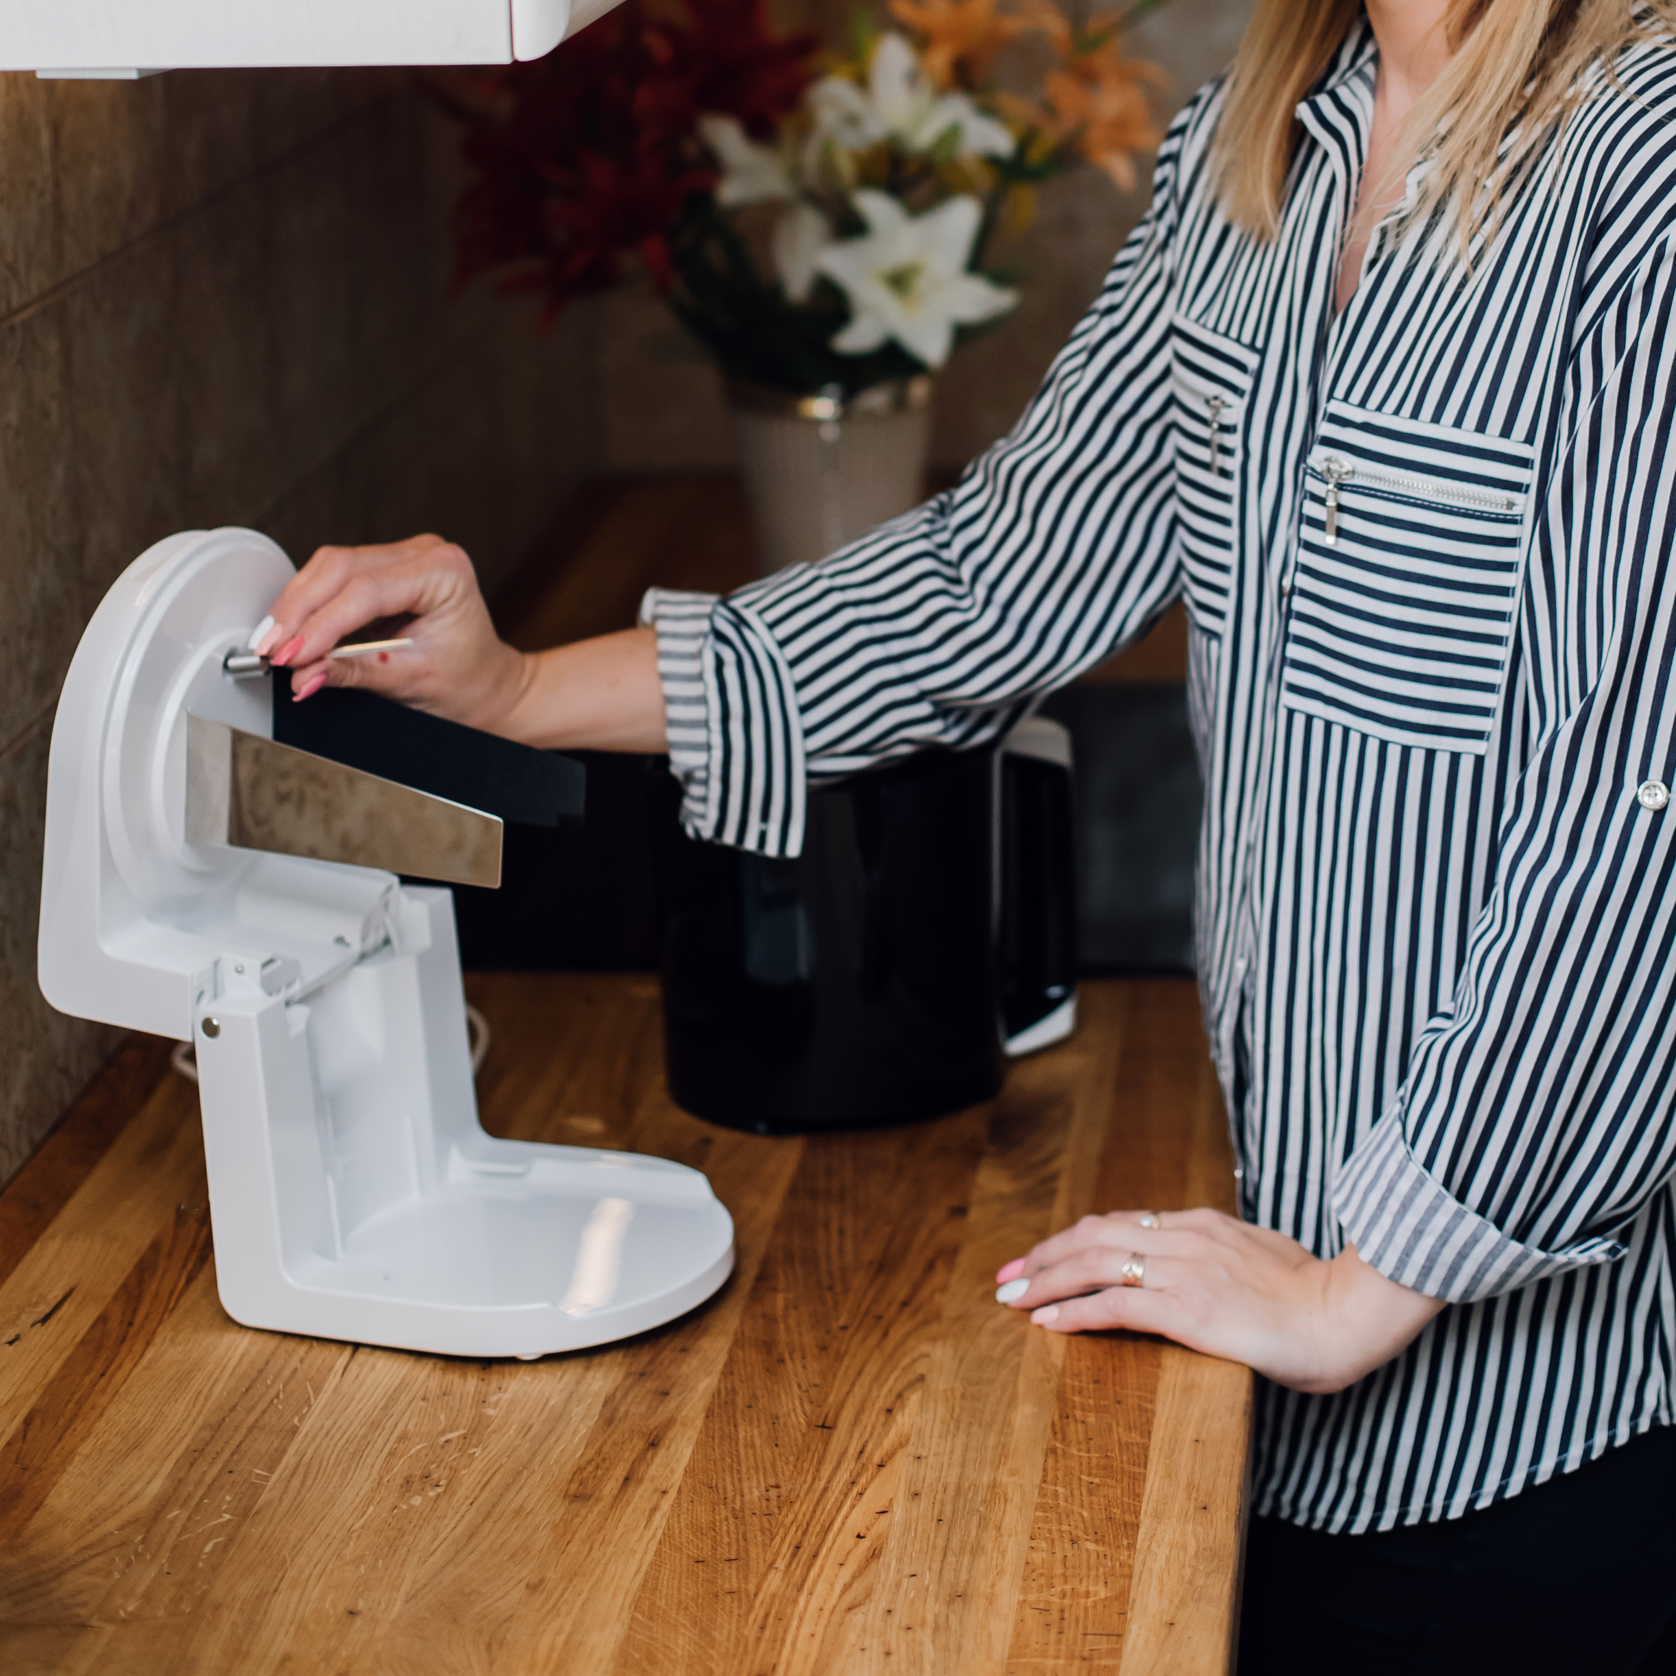
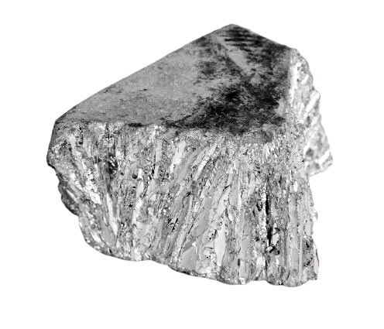
An ancient solution
Silver water
2022 | Lithuania

Slide 29
Why should you care?
Silver water
eNforce immune system
Help heal difficult wounds
Help heal cells after a burn
2022 | Lithuania
AntImi-crobial proper-ties
natural anti-biotic
And much more!

Slide 30
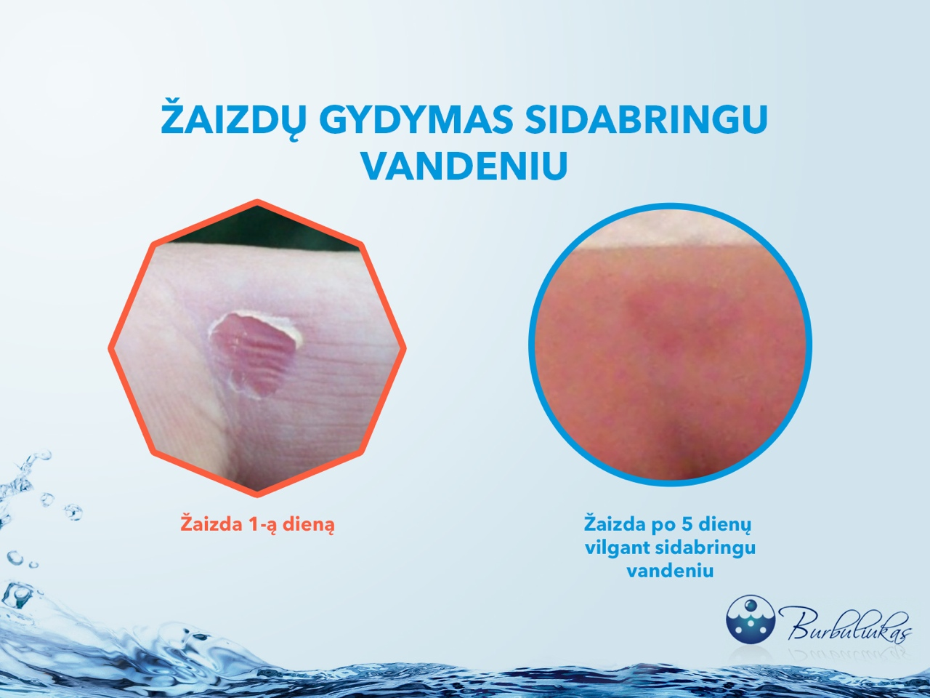
Healing wounds
Silvered water
2022 | Lithuania
Before
After

Slide 31
The real cost of bottled water
2022 | Lithuania

Slide 32
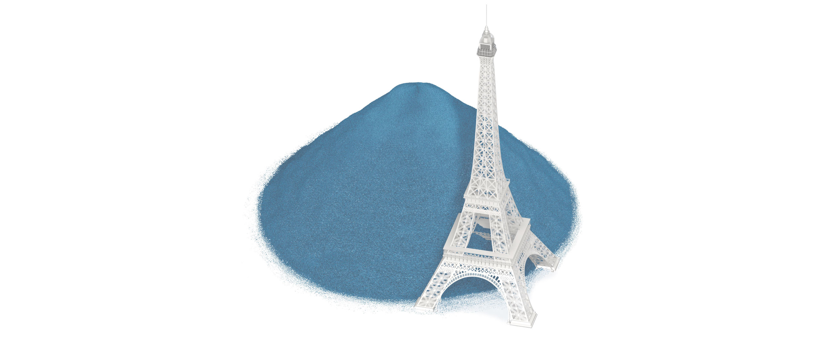
Bottled water and its plastic problem
Every day
1.3 billion bottles
Every day the equivalent of a bottle pile half the size of the Eiffel Tower in Paris is sold around the world.
2022 | Lithuania
Image credits: Reuters Graphics

Slide 33
6 glasses of ionised water a day for a happier, healthier life

Slide 34

Don’t take our word for it
❝ Alkaline water, made in a water ioniser, is the biggest discovery in healthcare since Alexander Fleming’s penicillin. ❞
2022 | Lithuania
Dr. W. Kelly

Slide 35
Join the movement
30 countries
2022 | Lithuania

Slide 36
What questions do you have?

Slide 37
The following are bonus slides you may want to use some time in the future

Slide 38
The cost of staying healthy
2022 | Lithuania

Slide 39
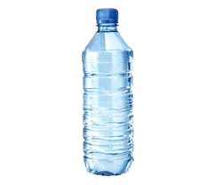
Hundreds of euros per year
Yearly per capita consumption of bottled water in Europe
2022 | Lithuania
Source: Statista, 2019.

Slide 40
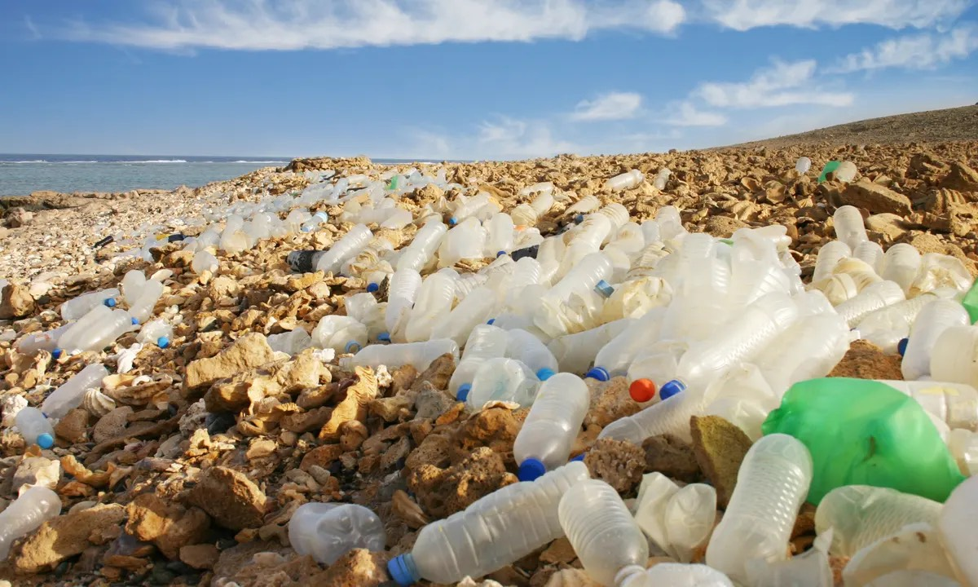
What it will cost you per year
+
+
2022 | Lithuania
1,000€
300€
∞ invaluable

Slide 41
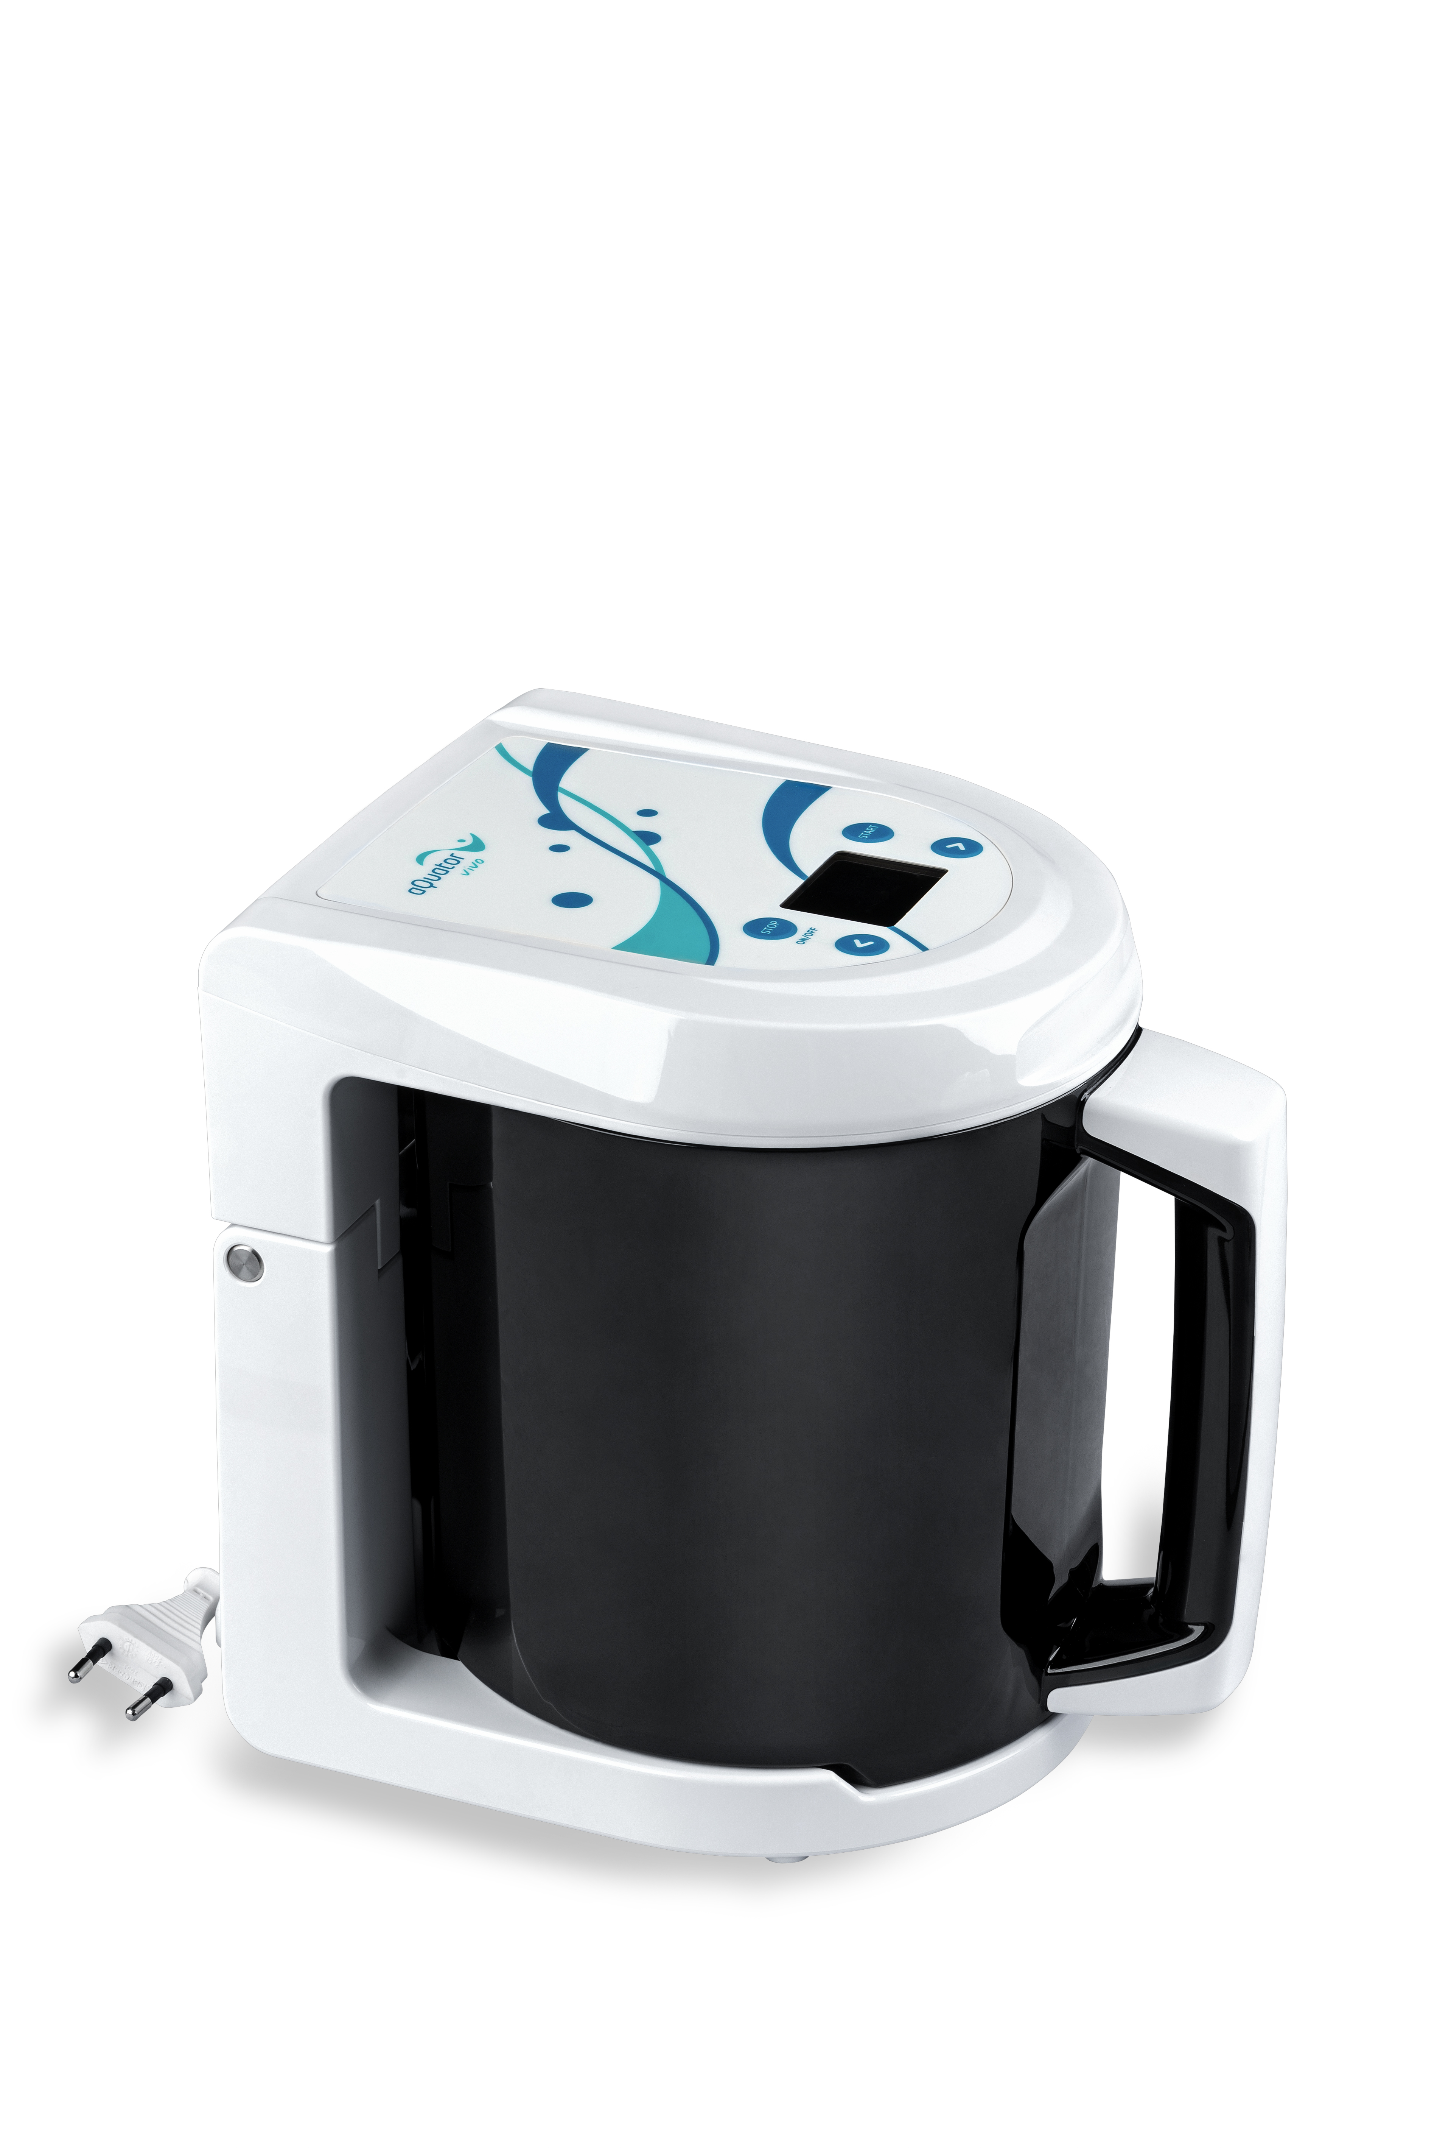
Ioniser, the cheaper solution in the long run
+
+
<
2022 | Lithuania

Slide 42
Only 450€ now, value for life
Water ioniser
2022 | Lithuania

Slide 43
We’re not saying we have the only answer
Staying healthy
2022 | Lithuania
Meditation
exercice
Healthy diet
Food supplements
Ionised water
Medical interventions

Slide 44
But it’s certainly an easy habit to adopt
Staying healthy
2022 | Lithuania
Meditation
exercice
Healthy diet
Food supplements
Ionised water
Medical interventions

Slide 45
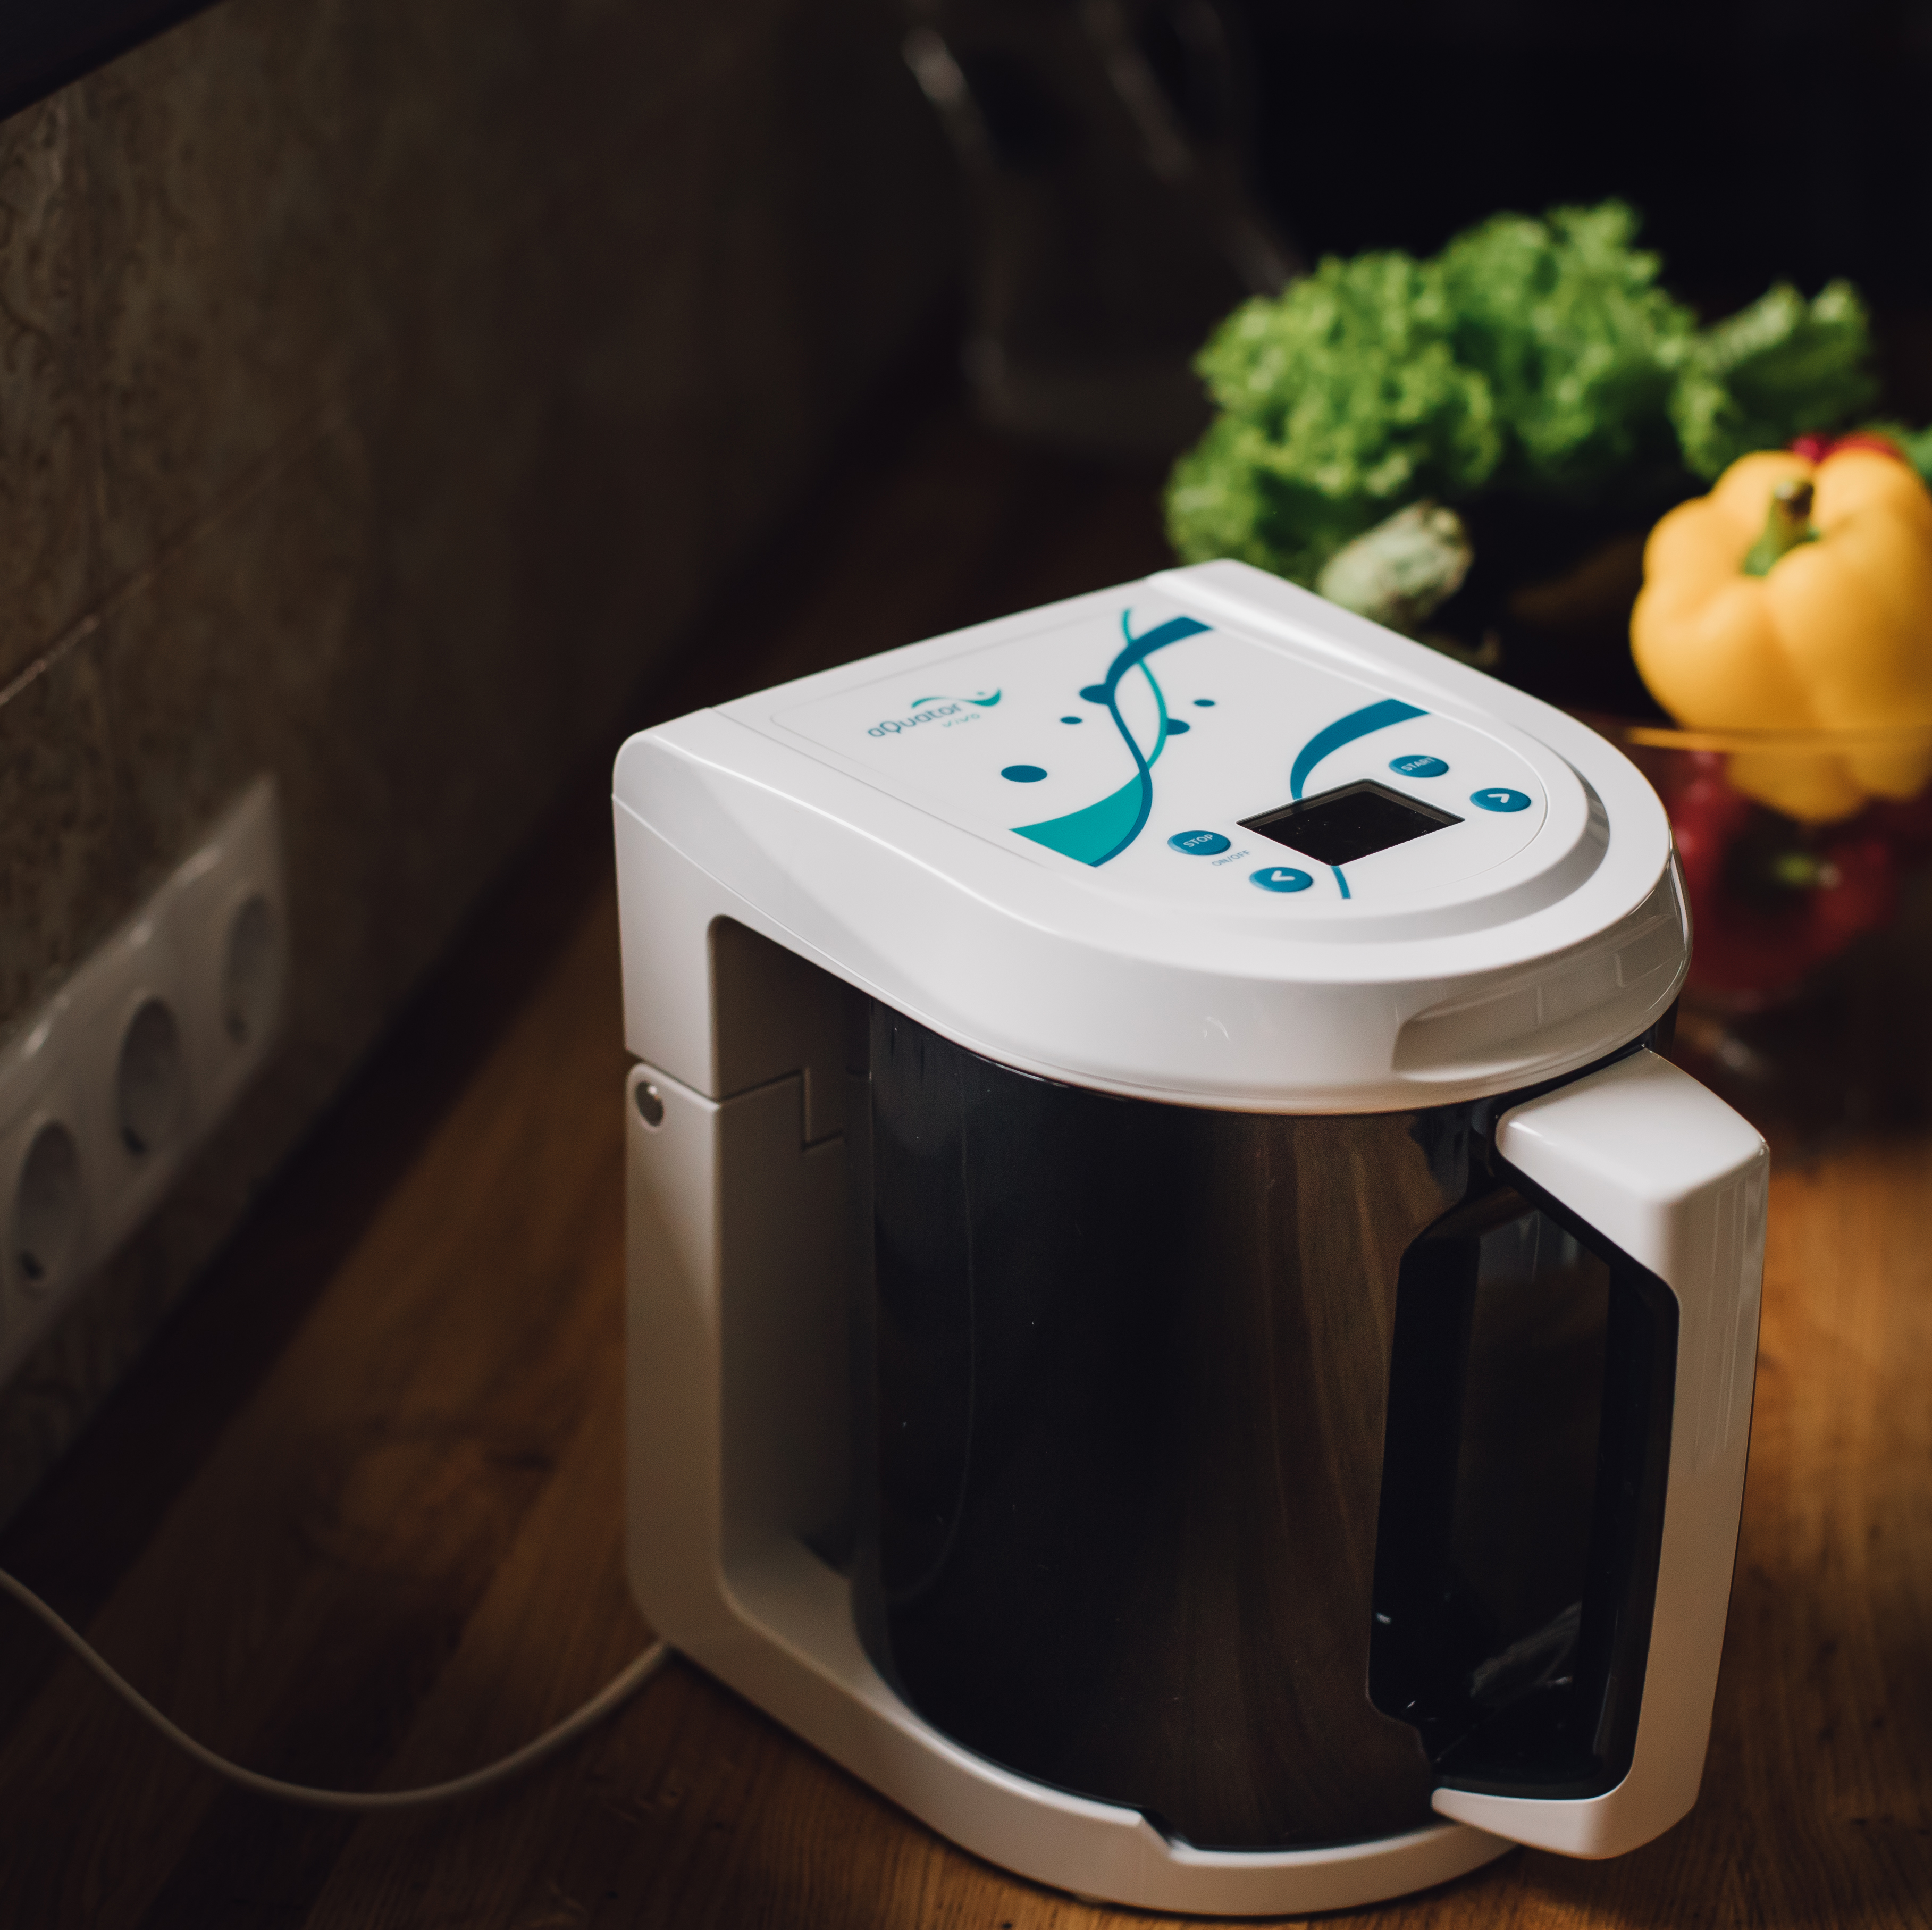
It’s easy to store
2022 | Lithuania

Slide 46
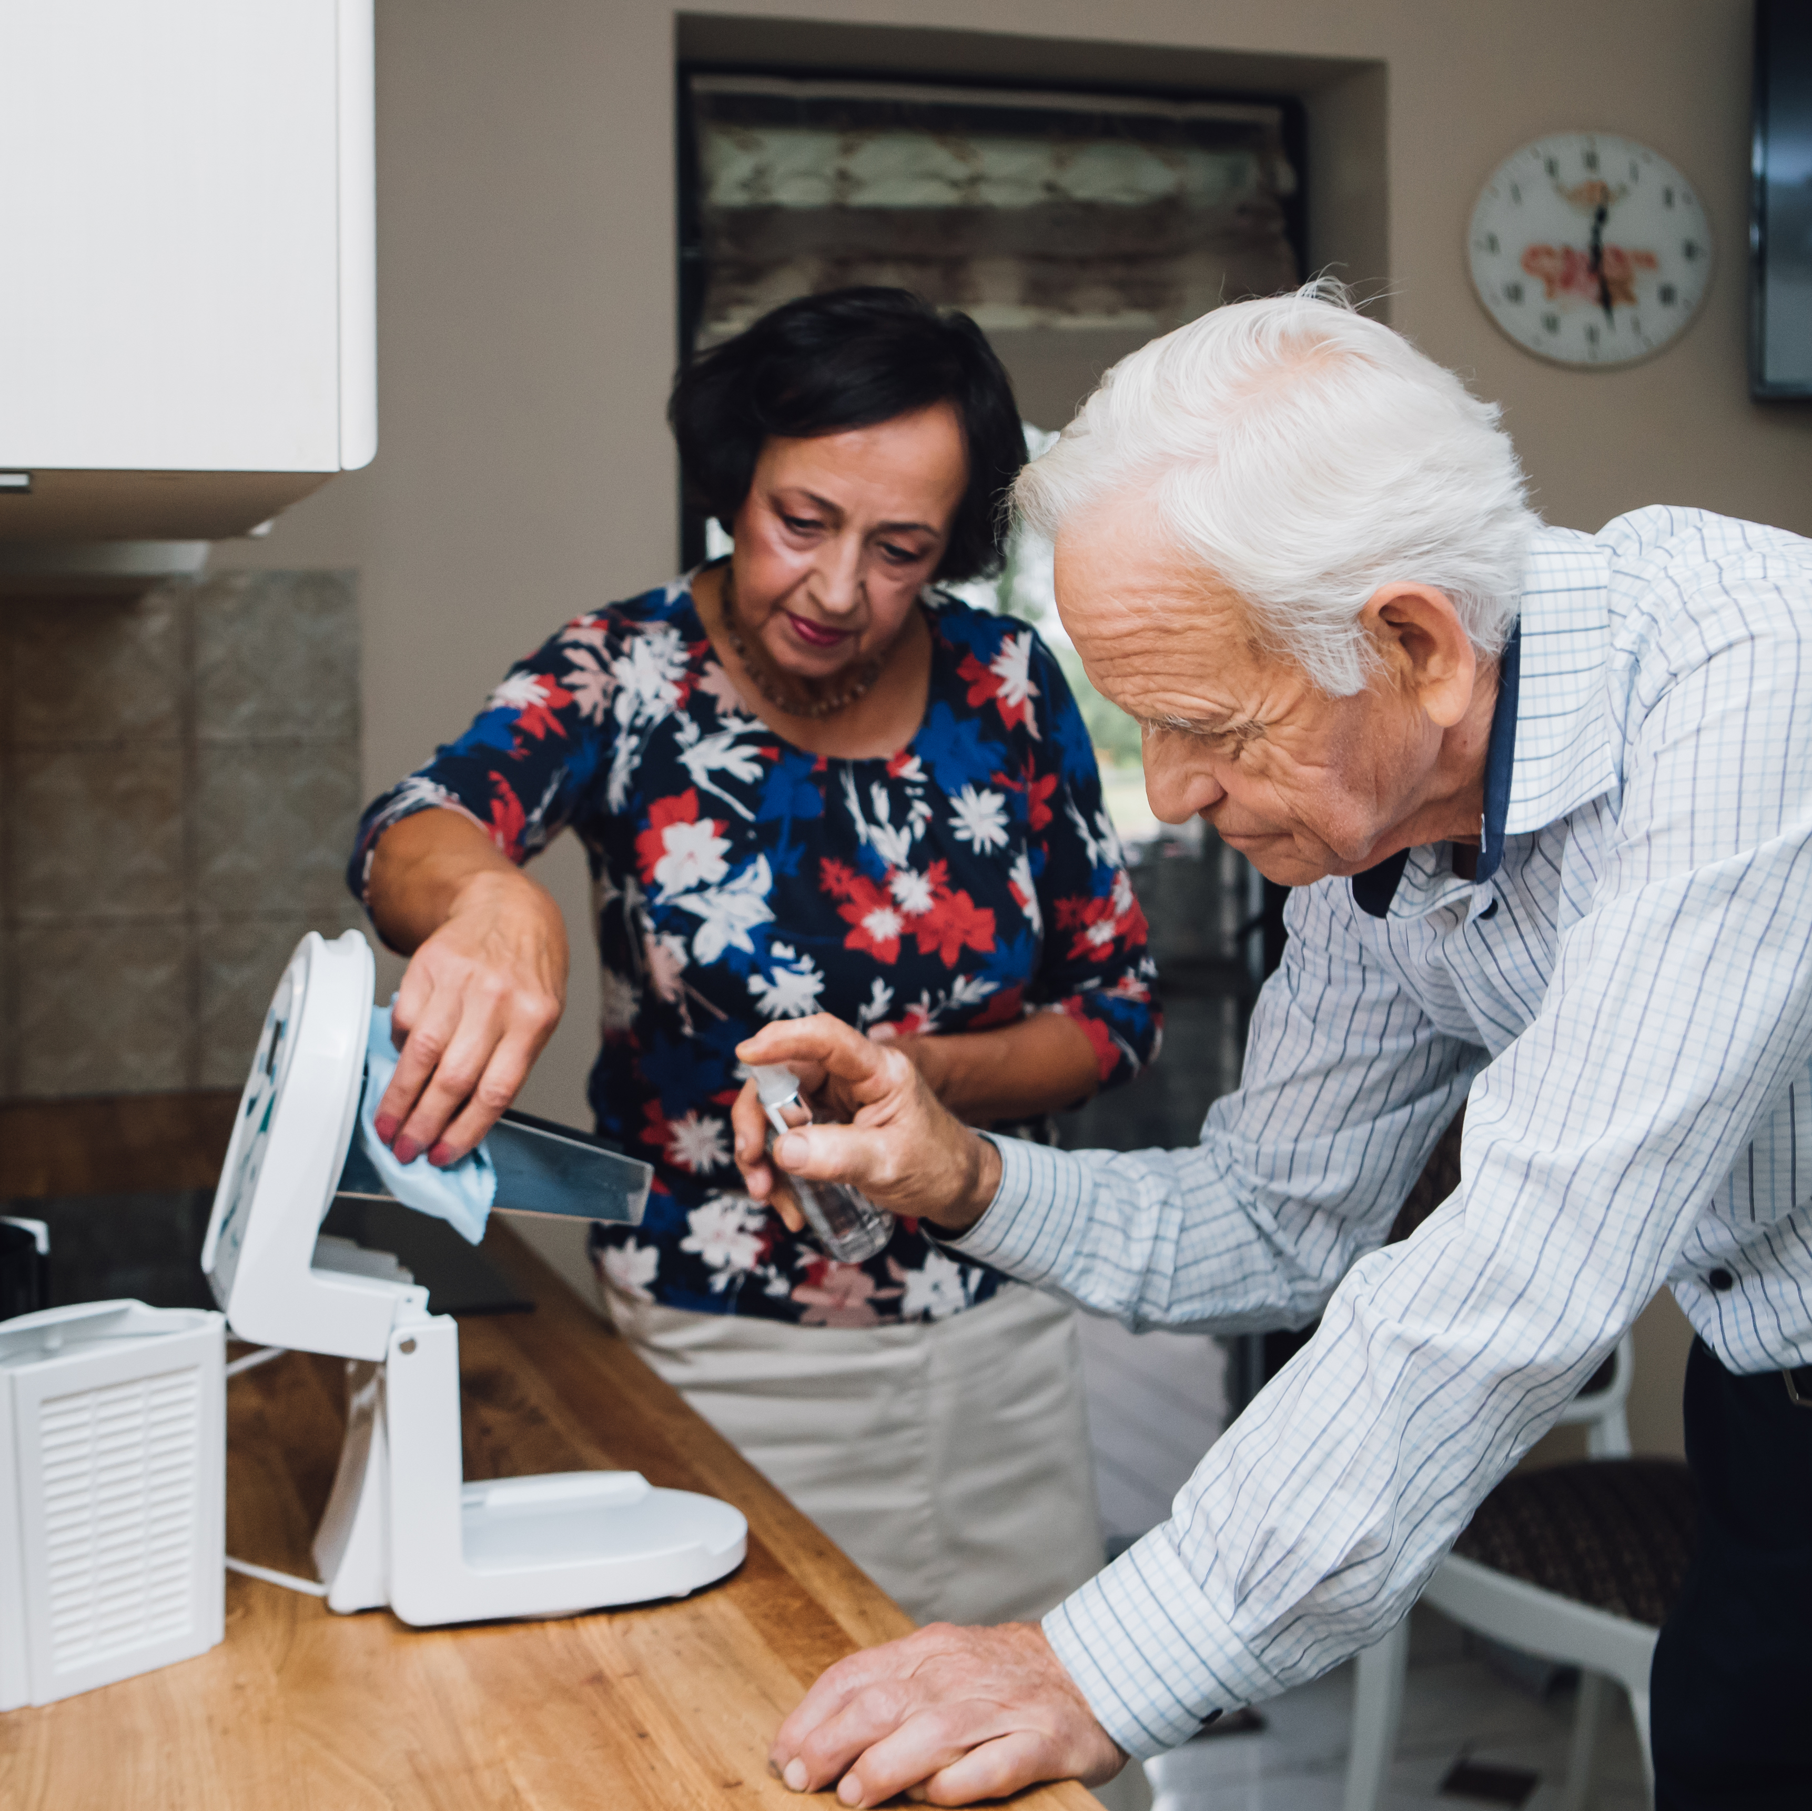
Easy to clean
2022 | Lithuania

Slide 47
Ionised water
It only takes a few minutes
15min
2022 | Lithuania
Daily water prep time

