Slide 1

Ready for the next health revolution?

Slide 2
50%
2022 | Lithuania

Slide 3
WATER.
2022 | Lithuania

Slide 4
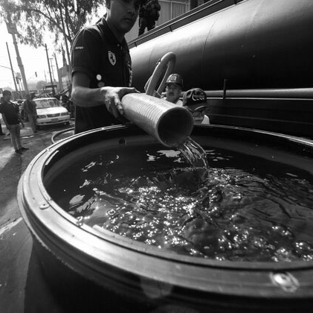
Good quality water is rare
The water problem
2022 | Lithuania

Slide 5
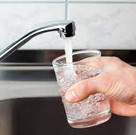
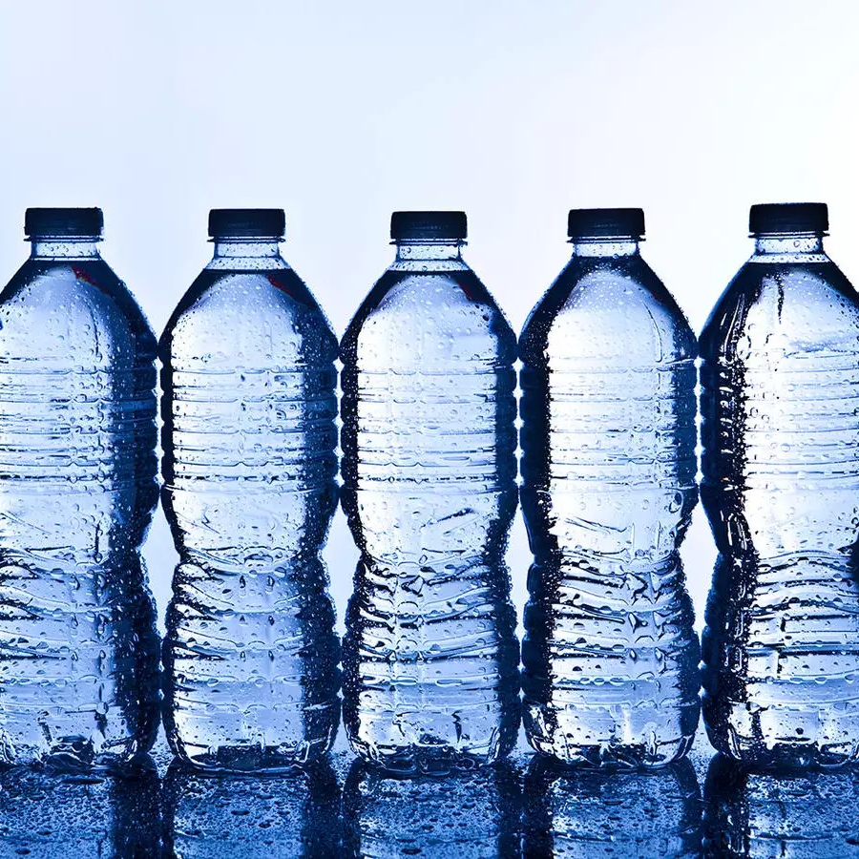
Tasty water is even rarer
The water problem
2022 | Lithuania
Smells of chemicals
Tastes like plastic

Slide 6
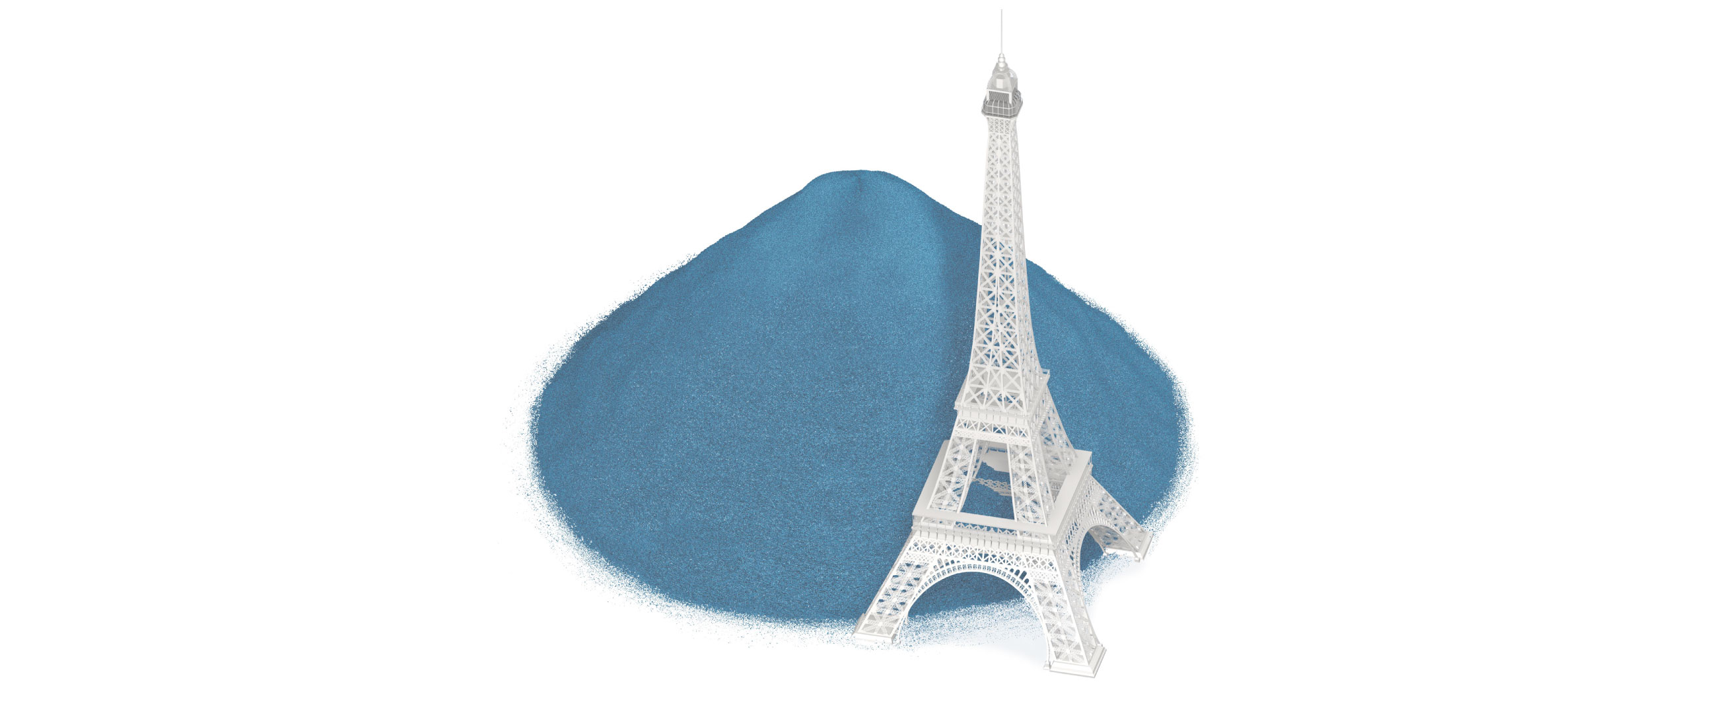
The environmental impact is scary
The water problem
Every day
1.3 billion bottles
Every day the equivalent of a bottle pile half the size of the Eiffel Tower in Paris is sold around the world.
2022 | Lithuania
Image credits: Reuters Graphics

Slide 7
Why work with us?
2022 | Lithuania

Slide 8
2022 | Lithuania
Growth
innovation
collaboration

Slide 9
2022 | Lithuania
Growth
innovation
collaboration

Slide 10
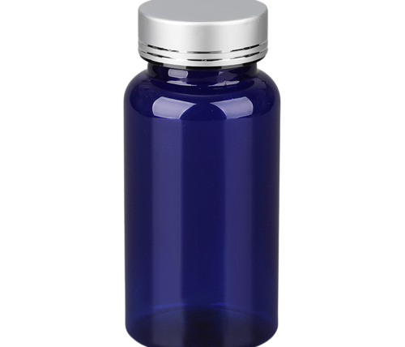
Thousands of euros per person
Value of the dietary supplement market, in billion euros
2022 | Lithuania
Source: Statista, 2020.

Slide 11
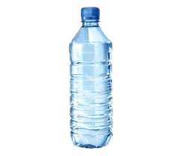
Hundreds of euros per person
Yearly per capita consumption of bottled water in Europe
2022 | Lithuania
Source: Statista, 2019.

Slide 12
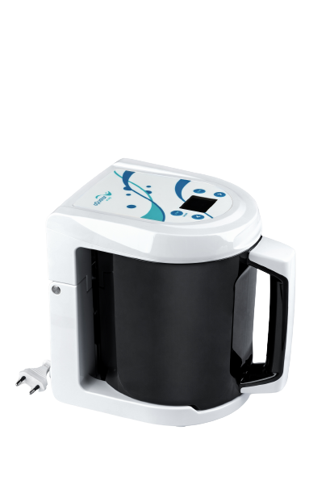
5.5% growth in six years
The value of the global water ioniser market
2,660M$
1,830M$
2022 | Lithuania
Source: Industry research, 2021.

Slide 13
Two thirds spent on products
The global wellness market
1.5 trillion$
2022 | Lithuania
Source: McKinsey, 2021.

Slide 14
Worldwide reach
30 countries
2022 | Lithuania

Slide 15
2022 | Lithuania
Growth
innovation
collaboration

Slide 16
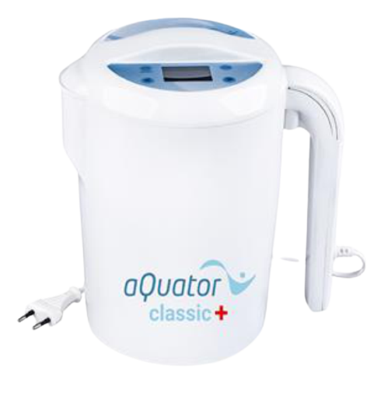
Our portfolio
A vast choice
2022 | Lithuania
aQuator silver
Vivo enhanced
Genius
Water purifiers

Slide 17
aQuator silver
Our portfolio
2022 | Lithuania

Slide 18
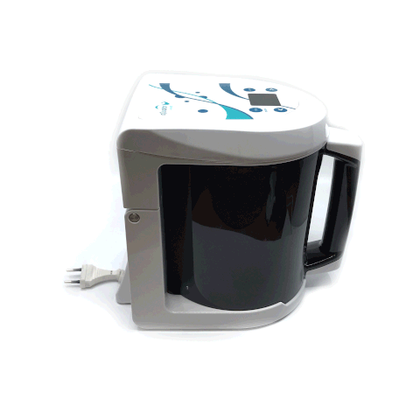
Vivo enhanced
Our portfolio
2022 | Lithuania

Slide 19

Genius
Our portfolio
2022 | Lithuania

Slide 20
Water purifiers
Our portfolio
2022 | Lithuania

Slide 21
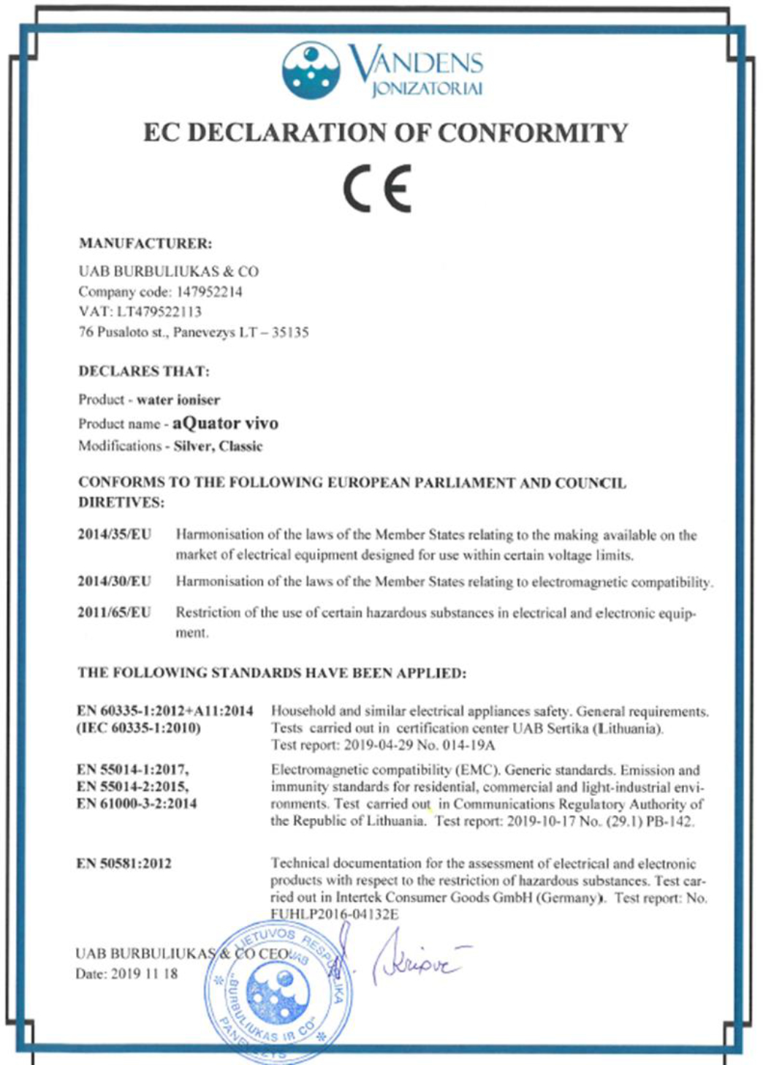
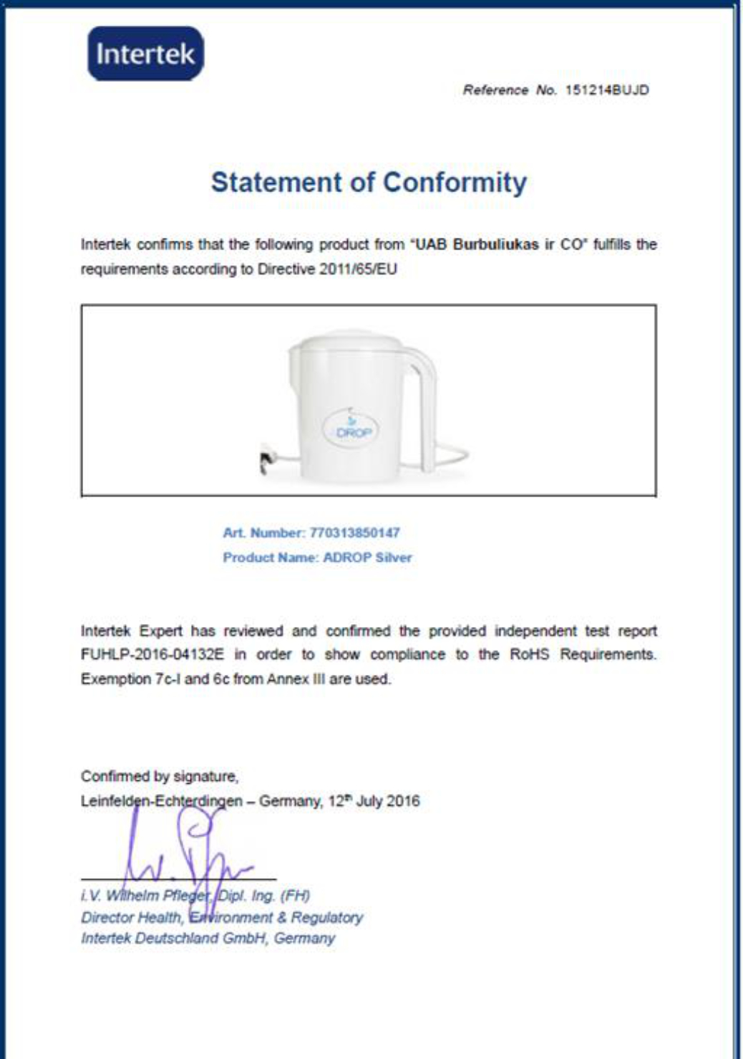
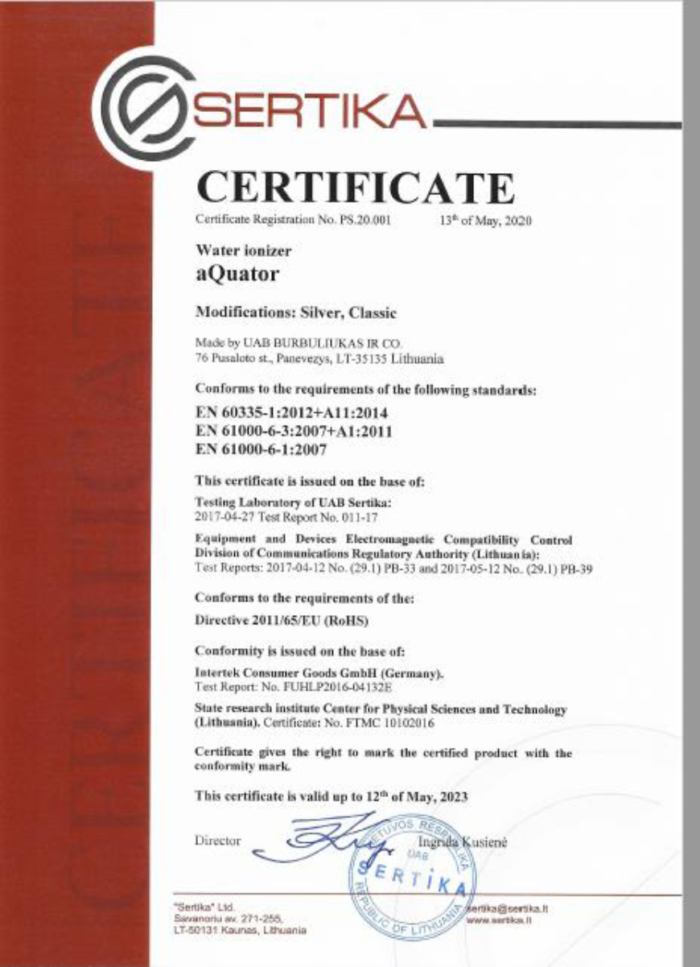
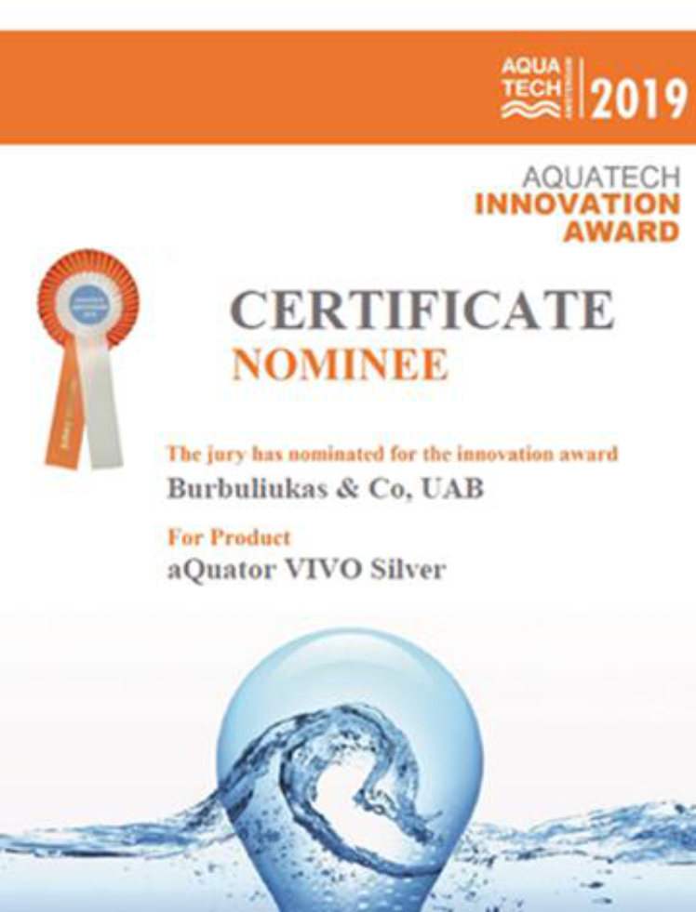
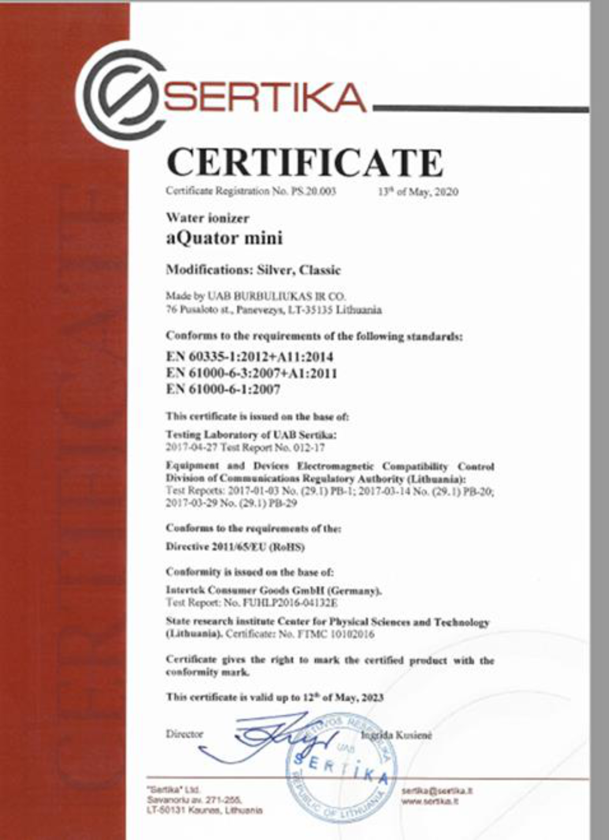
Top quality
Our ionisers
2022 | Lithuania

Slide 22
2022 | Lithuania
Growth
innovation
collaboration

Slide 23
High margin guaranteed
Working with us
50%
2022 | Lithuania

Slide 24
What you can earn
Working with us
2022 | Lithuania
200€
=

Slide 25
What you can earn
Working with us
If every day you sell..
1 ioniser
2 ionisers
3 ionisers
2022 | Lithuania
Your monthly profit will be..
6,000€
12,000€
18,000€

Slide 26
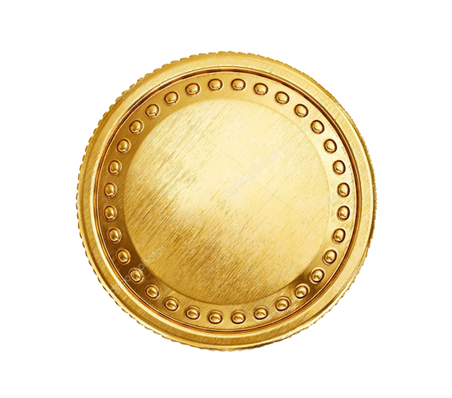
Your monthly earnings
What you can earn in one month if you sell…
2022 | Lithuania

Slide 27
Monthly earnings
Working with us
€24 000
€18 000
2022 | Lithuania
€12 000
€6 000
If every day you sell..
1 ioniser
2 ionisers
3 ionisers
3 ionisers

Slide 28
How we will help
Working with us
2022 | Lithuania
Marketing plan prep
Sales coaching
Individual mentoring
Know-how sharing
Ad-hoc assistance

Slide 29
An iterative approach
Working with us
Partnership starts
Annual plan
Sales start
2022 | Lithuania
Evaluation and iteration

Slide 30
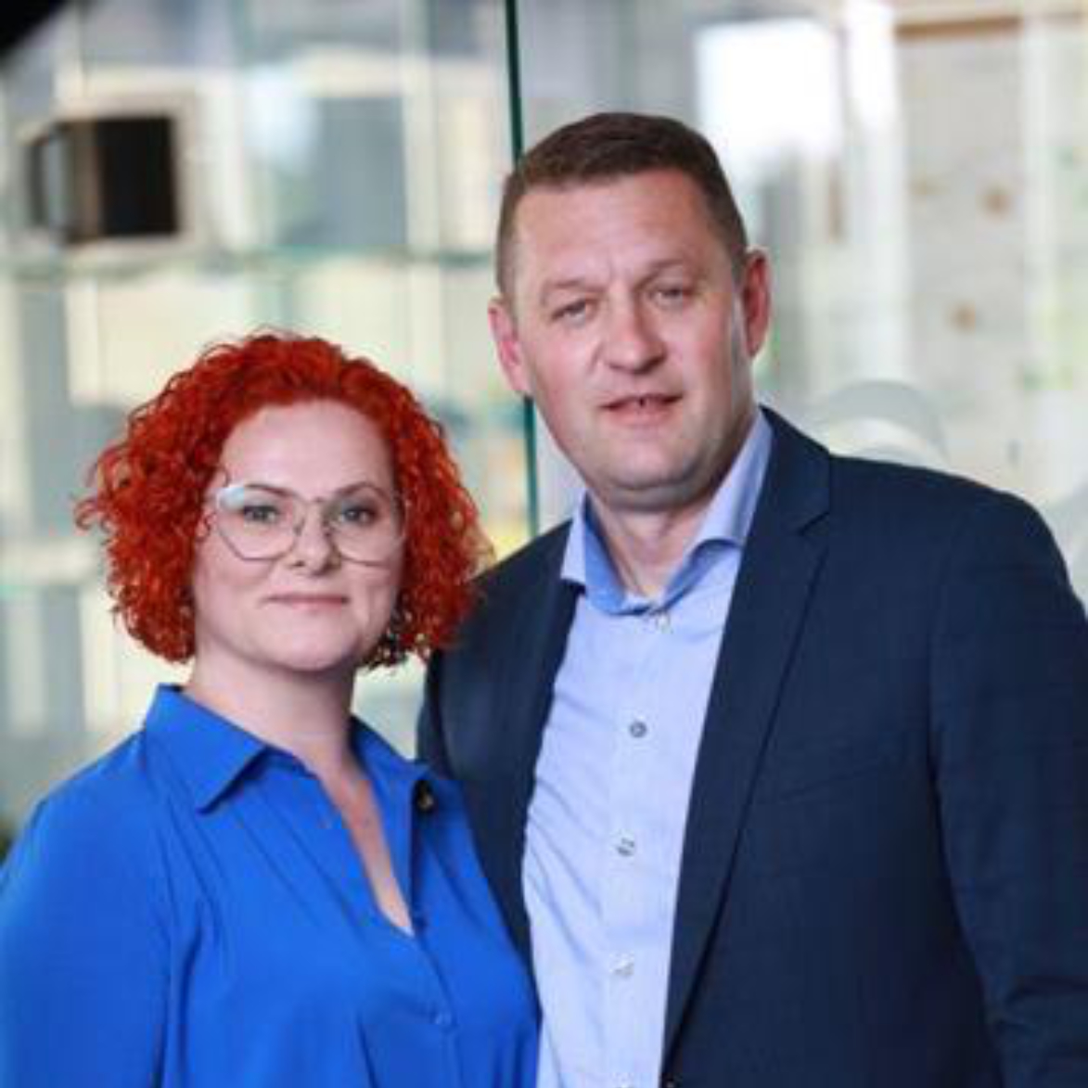
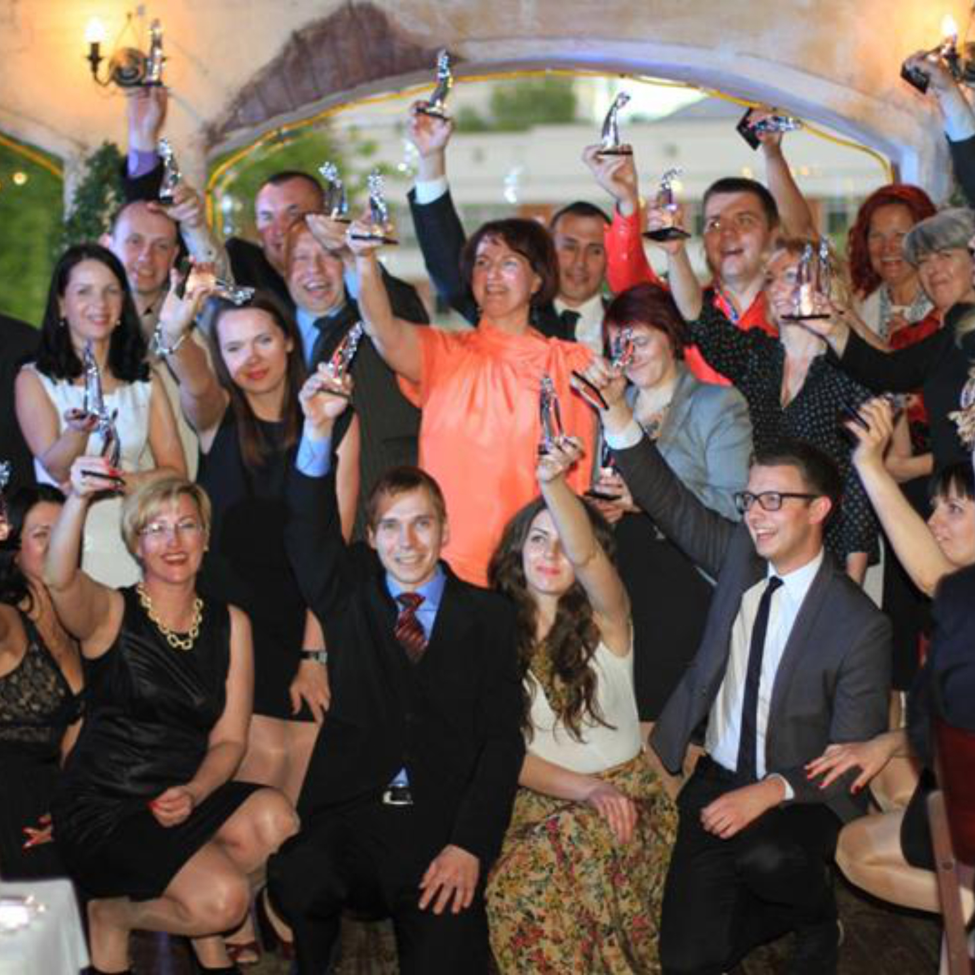
Your future collaborators
Working with us
2022 | Lithuania
Leaders, Inga & Sigitas
The team

Slide 31
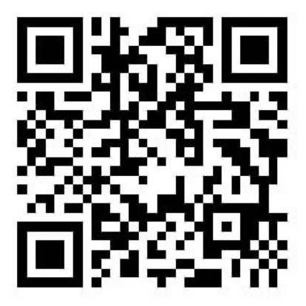
Don’t miss your chance to work with us!
Reach out
info@burbuliukas.lt
www.aquatorioniser.com

